Slide 1
WHERE DOES OUR ENERGY COME FROM?

Slide 2
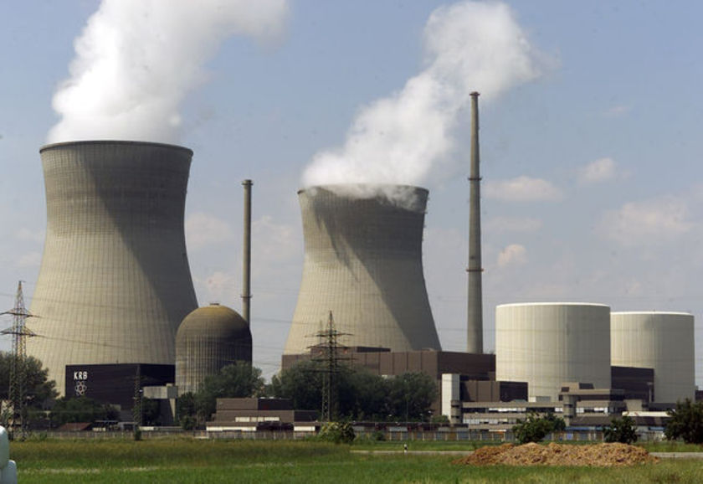
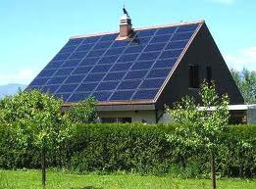
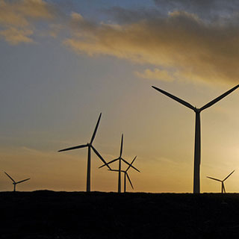
Energy SOURCES
NON RENEWABLE
Do not regenerate as fast as we consume them
Risk of running out!
Coal, oil, gas
RENEWABLE
Have an endless supply
At this stage are more costly to begin using as infrastructure must catch up!
Hydro, Wind, Solar, Biomass, geothermal, tidal etc.

Slide 3
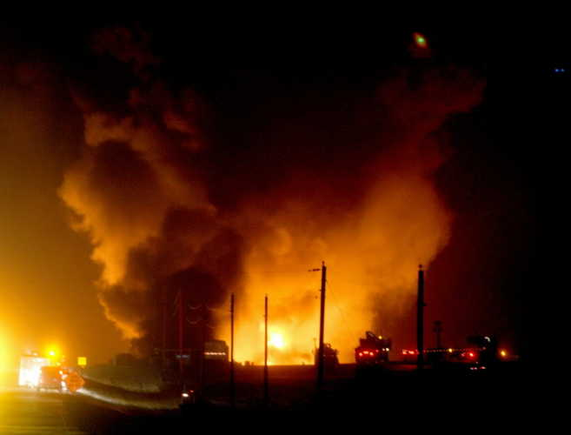
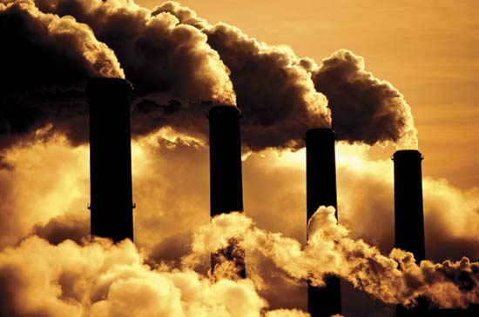
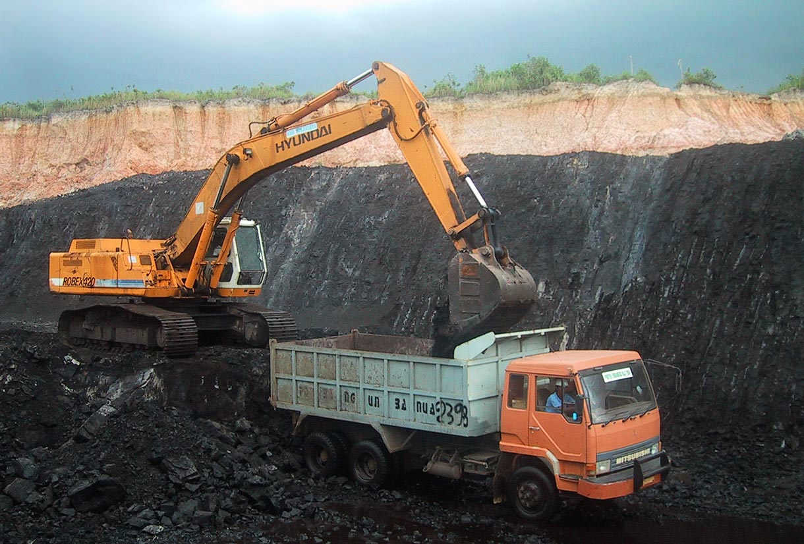
What is a Fossil Fuel???

Slide 4
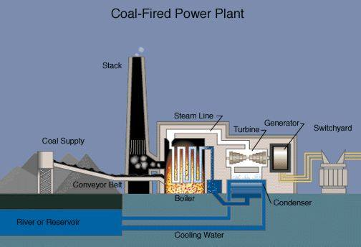
Thermoelectric generating plants
ANY FUEL

Slide 7
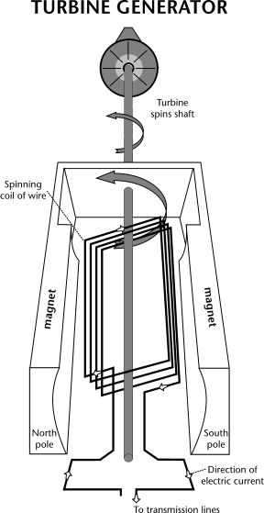
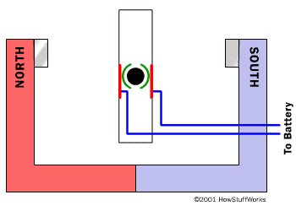
How Does a Generator Work?

Slide 8
Fuels for Thermoelectric
Biomass (Algae? Wood, Peat, straw etc.)
Nuclear
Fossil Fuels
Garbage

Slide 9
